Slide 1
NETWORK PROVIDER DATABASE MANAGEMENT SYSTEM
TEAM MEMBERS | NU ID
SRUTHI BHASKAR | 002791003
NIHARIKA VITTAL | 001523748
SOUMYA RAYAPPANOR | 002747973
Project Demo
December 10, 2022

Slide 2
ER Diagram

Slide 3
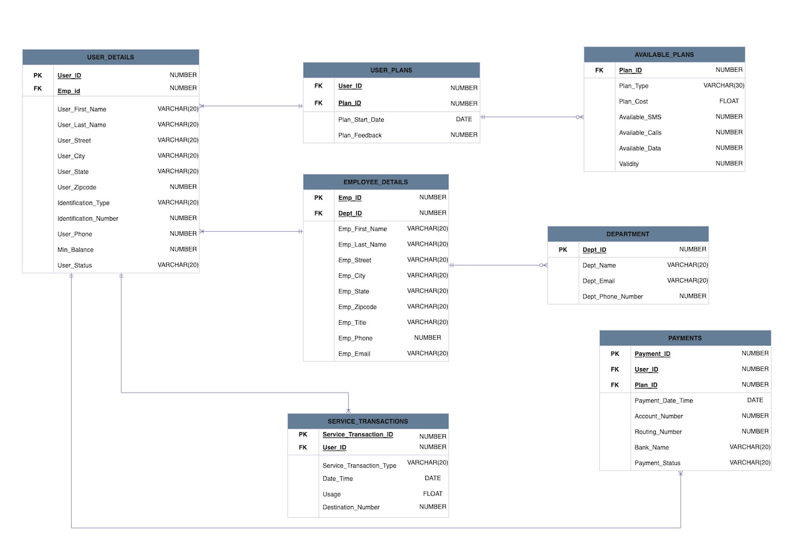

Slide 4
Network Provider Database Management System Design

Slide 5
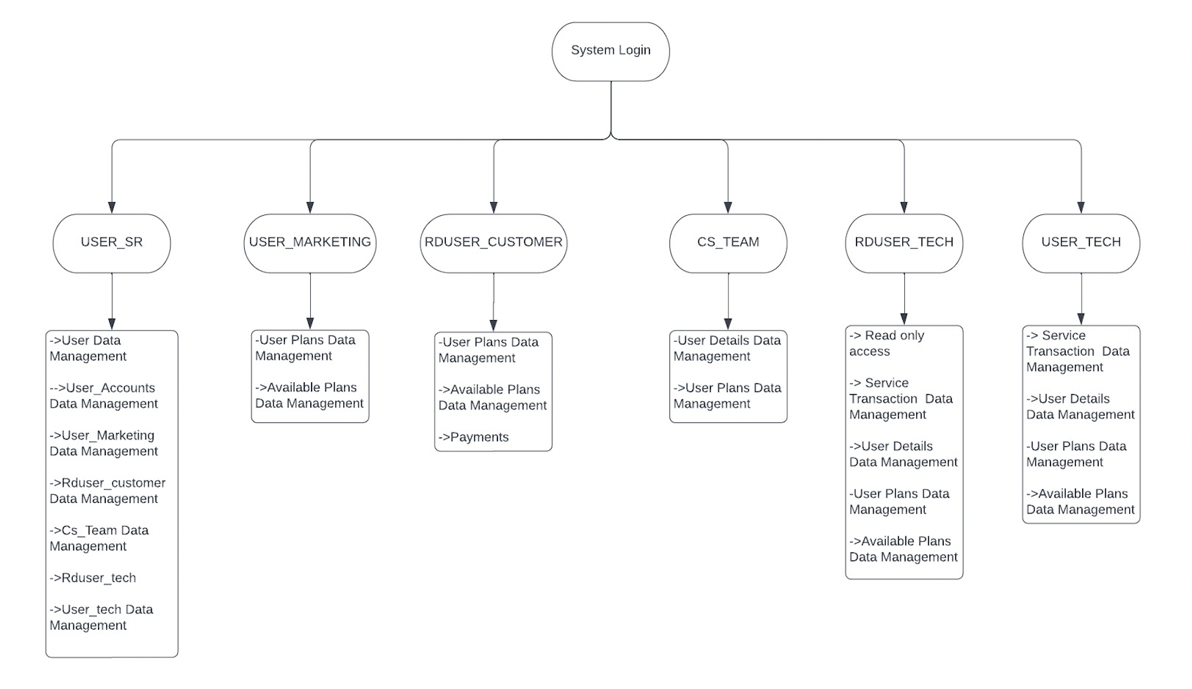

Slide 6
System Functionalities

Slide 7
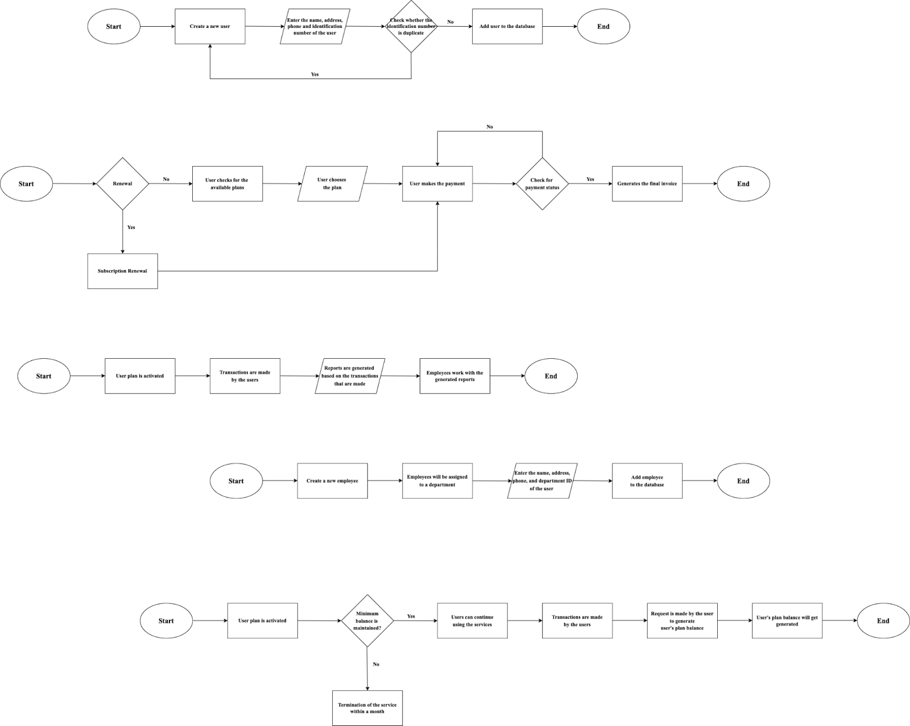
USER Module
EMPLOYEE Module

Slide 8
PLANS and PAYMENT Module
User’s Balance Module

Slide 9
Deliverables

Slide 10
Tables

Slide 11
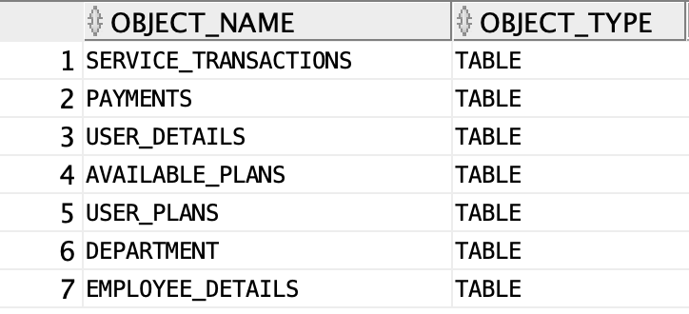

Slide 12
Views

Slide 13
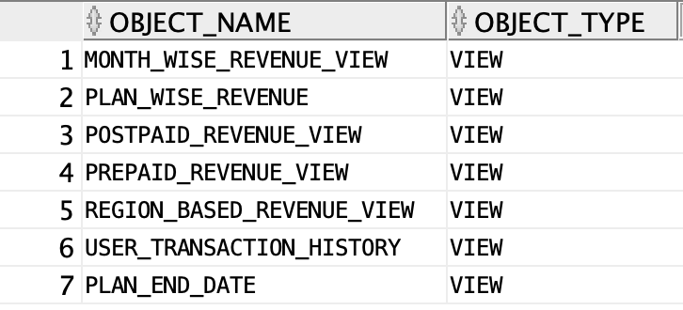

Slide 14
Indexes

Slide 15
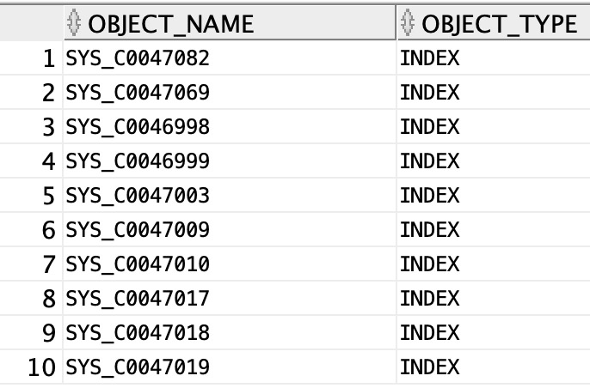

Slide 16
Triggers

Slide 17
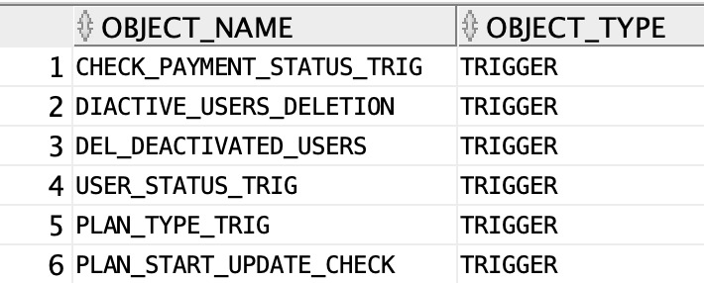

Slide 18
Stored Procedures, Functions, Packages & Sequences

Slide 19
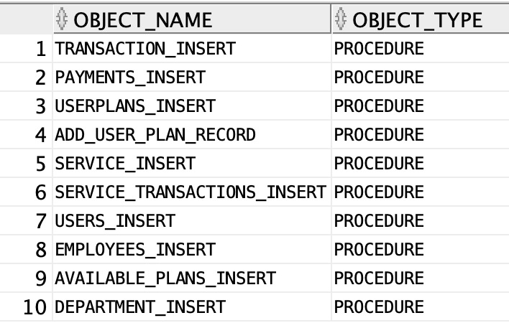
STORED PROCEDURES

Slide 20
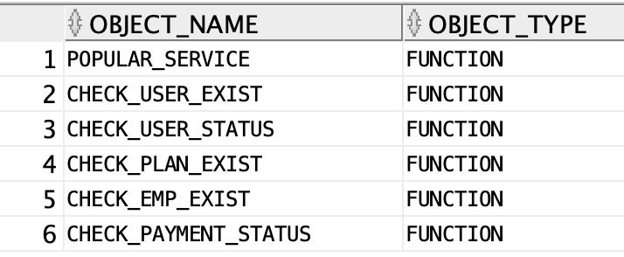
FUNCTIONS

Slide 21
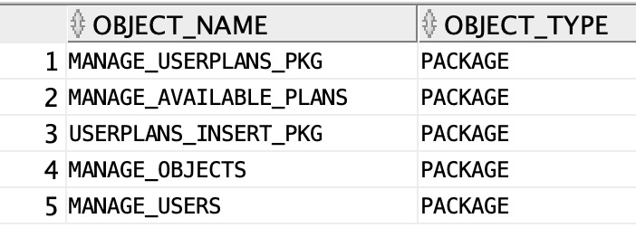
PACKAGES

Slide 22
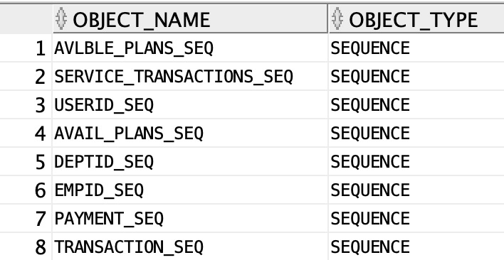
SEQUENCES

Slide 23
Team Contribution

Slide 24
Niharika Vittal
Table creation and inserting data
Triggers
Indexing
Packages
Documentation and PPT
Testing
GitHub

Slide 25
Sruthi Bhaskar
Table creation and inserting data
Functions
Procedures
Views
Triggers
Testing
GitHub

Slide 26
Soumya Rayappanor
Table creation and inserting data
Sequences
Procedures
Packages
Implementing Security
Creating User Roles
Security
Testing

Slide 27
Thank You!

